Slide 1

Tinkering & Mentoring - VACC 201
Final Project Presentation &
Demonstration
ChitoPack - Shrimp-Shell
Biodegradable Packaging
Date: 05/05/2026
Name of the Presenter: SOS_01
Email Id:25sc02003@gsfcuniversity.ac.in
Mobile No.: 8140671519
Faculty Mentor Name: Dr. Sejalben Rathod
Team No.:SOS_01
Semester: 2nd
Program: BSc Biotechnology
School: School of Science

Slide 2
Chitopack- shrimp shell packaging
Student Team
Name | Enrollment No. | Key Responsibility
AGARWAL KHUSHI BHARATBHAI | 25SC02001 | Review Literature
AMAN KUMAR MALAKAR | 25SC02002 | Protocol development
AYESHA HAYAT ANSARI | 25SC02003 | Ideation & Team Leader
BANJARA DARSHAN PRADEEPBHAI | 25SC02004 | Lab procurement
BARIYA JIYA BIPINBHAI | 25SC02005 | Product Testings
BAROT KHYATI ANANTBHAI | 25SC02006 | Compile report/data

Slide 3
Chitopack- shrimp shell packaging
Faculty Mentor
Name | Designation | Department, School
DR. SEJAL RATHOD | ASSISTANT PROFESSOR | DEPARTMENT OF LIFE SCIENCE, SCHOOL OF SCIENCE

Slide 4
Chitopack- shrimp shell packaging
Introduction of Tinkering Project
Title of Tinkering Project: ChitoPack- Shrimp-shell Biodegradable Packaging
Sector: Environment/Sustainable Packaging
Brief: Plastic packaging causes environmental pollution.
Shrim shells are waste but contain useful biopolymer(chitin).
Aim: Develop biodegradable packaging using shrimp shell waste.

Slide 5
Chitopack- shrimp shell packaging
Methodology and Tinkering Process
Project Approach:
Focused on converting shrimp shell waste into biodegradable material.
Used low-cost and simple lab methods for development.
Tinkering Journey:
Initial trials resulted in coarse and unstable mixtures
Adjusted ratio of shrimp, starch, and water.
Modified process to achieve moldable consistency.
Final prototype developed using shot glass mould.

Slide 6
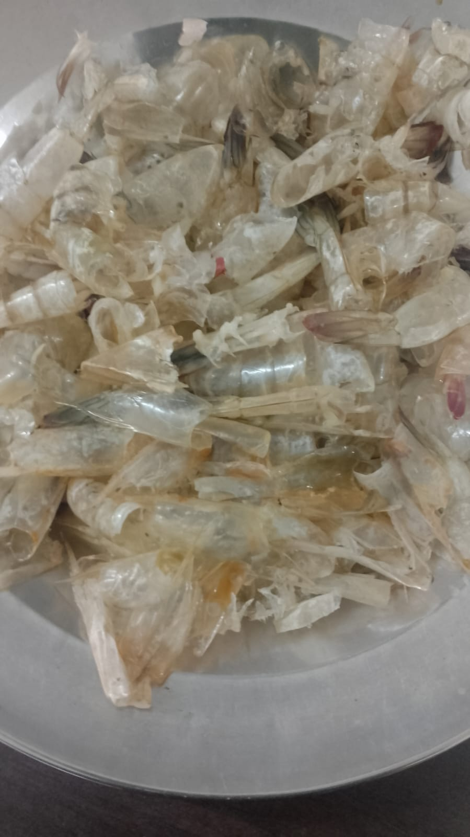
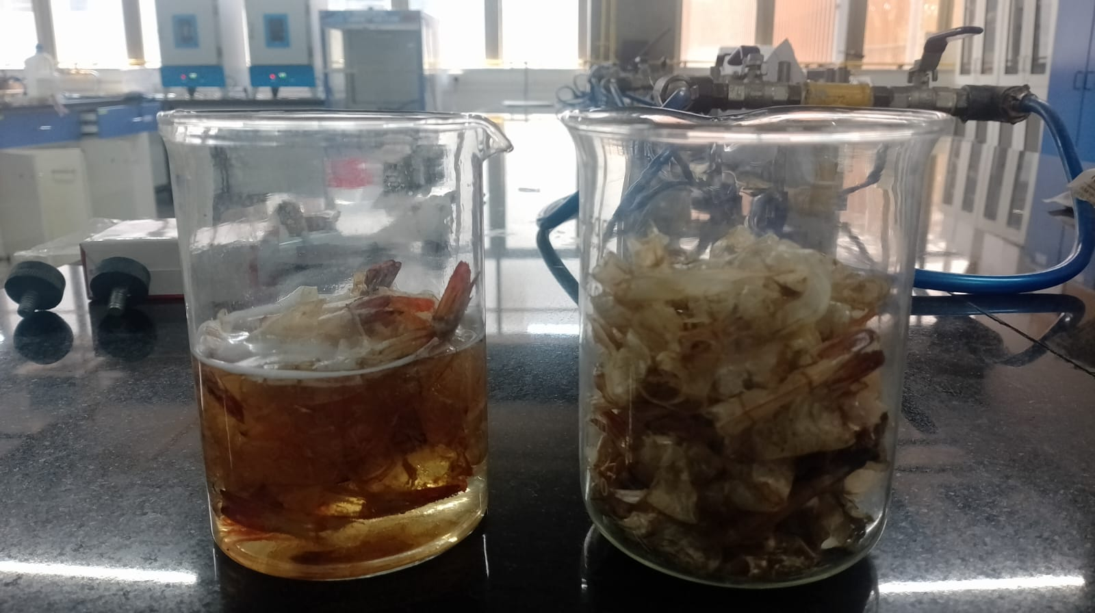
Chitopack- shrimp shell packaging
Methodology and Tinkering Process
Fig.2 Demineralisation with Glacial acetic acid(left)
Raw materai (right)
Fig.1 Raw Material(Shrimp shells)

Slide 7
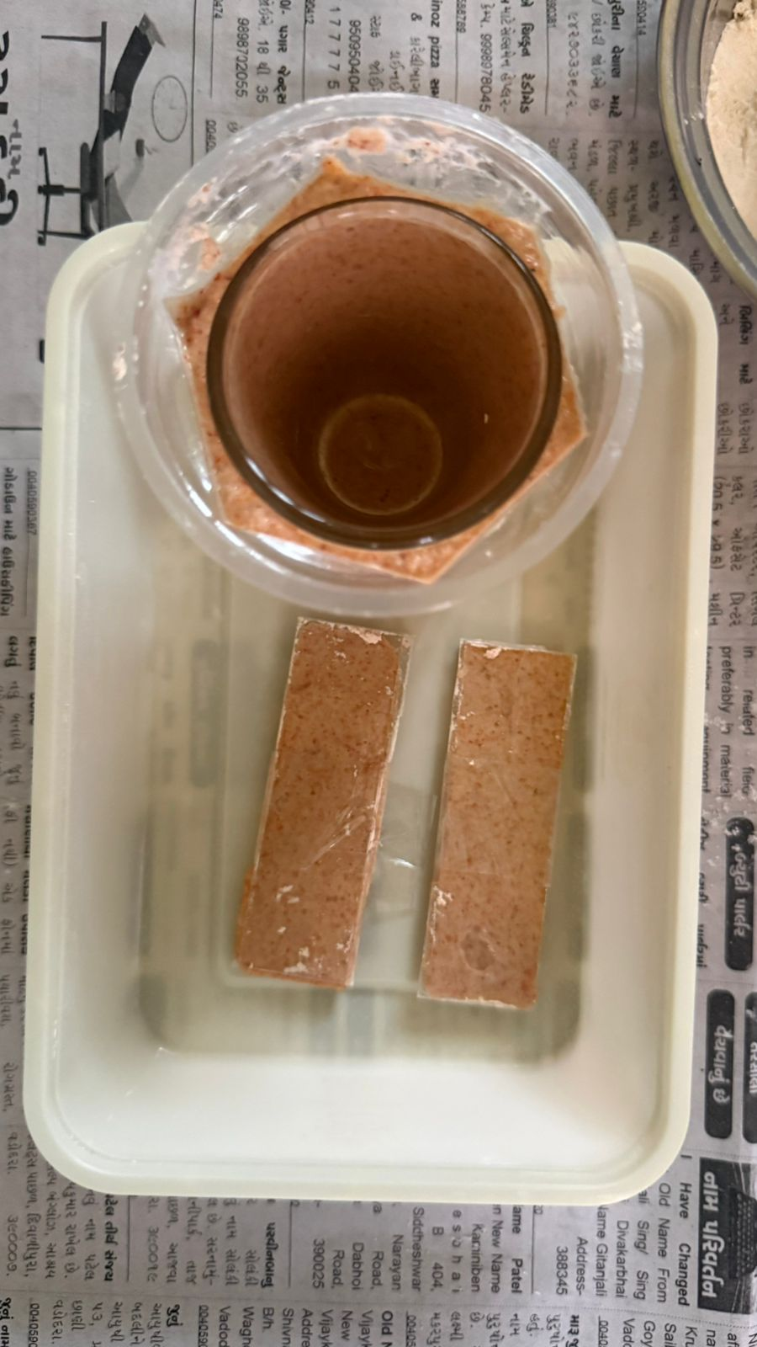
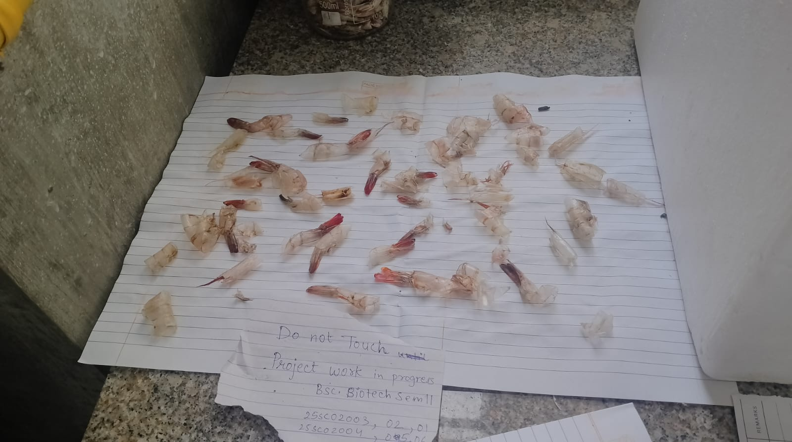
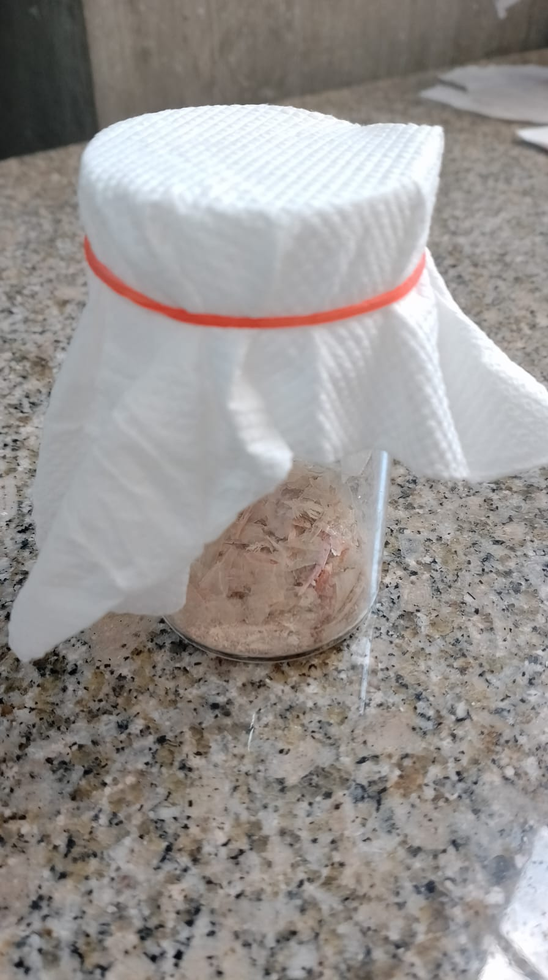
Chitopack- shrimp shell packaging
Methodology and Tinkering Process
Fig.3 Drying of treated shrimp shells.
Fig.4 Shrimp shell powder
Fig.5 Drying of mould and trial of thin films.

Slide 8
Chitopack- shrimp shell packaging
Methodology and Tinkering Process
Role of Mentoring:
Guidance in refining problem statement and approach
Suggestions for improving material building and new approach.
Feedback helped in iterative improvements of prototype.

Slide 9
Chitopack- shrimp shell packaging
Tools and Technology Used
Beaker and glassware: For cleaning and mixing of shrimp shells.
Heat source: Sunlight and Oven for drying process.
Mortar Pestle and Grinder: For crushing dried shrimp shells to powder form.
Thin glass mould and shots glass: For shaping/moulding.

Slide 10

Chitopack- shrimp shell packaging
Project Outcome & Development
Use case:
Biodegradable cushion packaging for small fragile items.
Description of the Developed Outcome:
Prepared a biodegradable composite using shrimp shell waster and starch.
Achieved moldable paste consistency after multiple trials.
Successfully formed a shot glass-shaped prototype using inner mould.
Shape retention after drying.

Slide 11
Chitopack- shrimp shell packaging
Project Outcome & Development
Development Process & Challenges:
Difficulty in achieving fine powder from shells.
Initial mixtures showed water separation and instability.
Early sample was brittle after drying(cracks developed).
Improvements made by:Adjusting composition ratio
Applying heat for better holding.
Adding plastisizer(glycerin).
Additional trials: Attempted formation of thin film structures.
Observed uneven texture and drying inconsistencies.

Slide 12
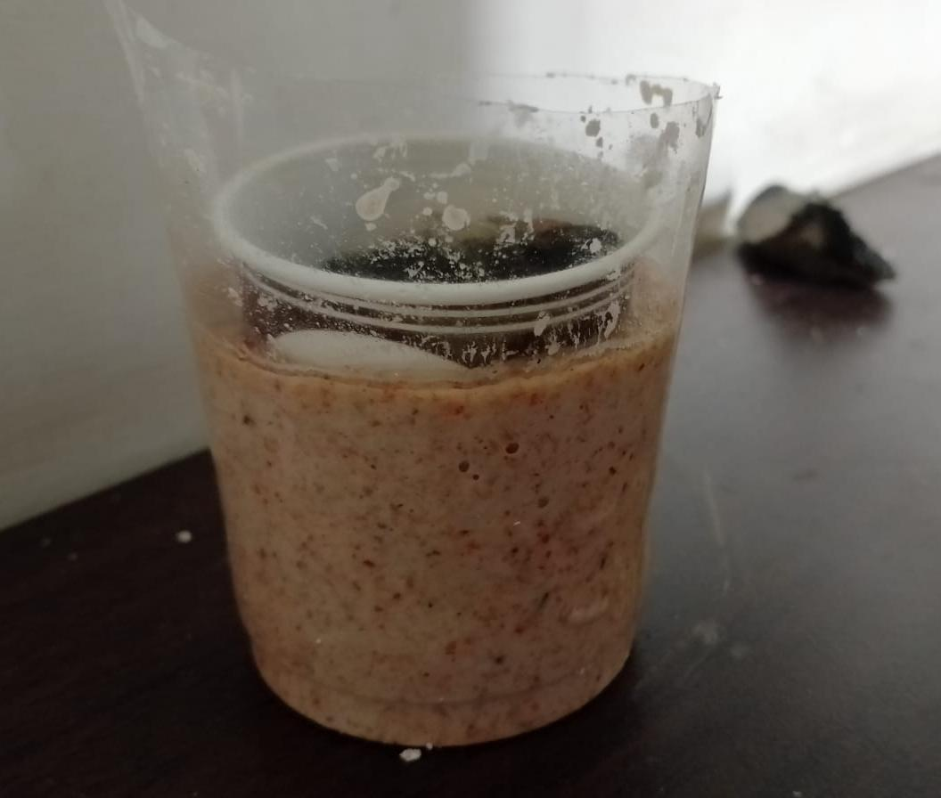
Chitopack- shrimp shell packaging
Prototype Image/Video
Fig. Initial prototype(3D mold structure)
Fig. Recent prototype(3D molded structure and thin film trial samples)

Slide 13
Chitopack- shrimp shell packaging
Learning Outcome
Key Learnings from the Project:
Understood conversion of biological waste into useful material.
Gained hands on experience in material preparation and molding techniques.
Learned importance of trial and error in prototyping.
Developed skills in problem solving and process optimization.

Slide 14
Chitopack- shrimp shell packaging
Conclusion & Future Scope
Conclusion:
Developed a biodegradable composite from shrimp shell waste
Achieved moldable structure (shot glass prototype)
Demonstrated feasibility of eco-friendly packaging.
Future scope:
Improve strength and flexibility
Develop uniform thin films
Scale for real-world packaging applications

Slide 15
Chitopack- shrimp shell packaging
Conclusion & Future Scope
Applications/Impact:
Sustainable packaging for small fragile items.
Utilization of marine waste(shrimp shells).
Reduces plastic pollution.
Reflection on Project Experience:
Learned importance of trial-and-error in prototyping.
Gained hands-on experience in material development.
Improved teamwork and problem-solving skills.

Slide 16
Chitopack- shrimp shell packaging
Do you want to apply for PoC/Prototype Development support under Students Startup and Innovation Policy (SSIP 2.0) under GUIITAR Council?
Open to exploring under SSIP(subject to further development)

Slide 17
Thank You..

